Slide 1

K.S. School of Business Management
Topic : Consideration
3186 - Shivani Darji
3193 – Hirpara Lisa
3197 – Dhruvi Khatri
3198 – Khushi koli
Mentor : Moinuddin sir

Slide 2
Indian Contact Act, 1872
Introduction :
INDIAN CONTRACT ACT, 1872 governs law relating to contacts in India.
Passes by British India
This Act is applicable to whole of India including Jammu and Kashmir.
The Act came into effect from 1st September, 1872.
Important Definitions under the Act :
Proposal(offer) – Sec 2(a)
Acceptance – Sec 2(b)
Agreement Sec 2(e)
Void Agreement – Sec 2(g)
Contact – Sec 2(h)
Is every agreement contact?

Slide 3
CONSIDERATION
Definition :
Exchange of benefits and/or obligations.
Without consideration a contact can not be enforceable.
Even if a person sells the car for ₹1, it would be a binding contact.
If he/she gives car for free, it will not be a contact -> Peppercorn Rule.
PEPPERCORN : if the consideration is as small as a peppercorn, it will do, but it must be there to form a contact.
Example: A signs a contract to buy a car from B for ₹5, 00,000, A’s consideration is ₹5,00,000 And B’s consideration is the car.
Example: A promises to pay B ₹1,00,00 if he will be able to run 200km in 5 minute.(Not Valid)
Example: B house is on fire. A rushes to B’s help and saved his life. In show of gratitude, B promises to pay A ₹5,00,000 for the help provided by A.

Slide 4

Agreement Against Revocation
The Indian contract Act lays out the rules of revocation of an offer in section 5.
It says the offer may be revoked anytime before the communication of the acceptance is completed against the proposal/offer.
Once the acceptance is communicated to the proposal, revocation of the offer is now not possible.
If a promise to keep the offer open is supported by consideration, an offeror is bound by the promise and can’t revoke the offer.
Illustration :
A offered to sell his property to B but decided to sell it to MR. C instead. B found out about the sale because Mr. D told him. This was legal, as there is no consideration between them.

Slide 5
Case Study :
Mr. S wants to sell his furniture. He writes about the same and makes an offer to his friend Miss K to buy the same. Miss K has just bought another house for which this furniture would be useful. So after going through the details she likes the same, writes to Mr. S stating that she has accepted the offer, and posts it to him, Miss K’s family is not OK with this second hand furniture. Hence, they convince her to refuse Mr. S’s offer. Miss K then sends in a fax to Mr. S stating that she has revoked her acceptance. In normal circumstances, a fax works faster than regular post. If Mr. S receives the fax first then we say that this is considered as proper, legal Revocation of Acceptance.

Slide 6

Pre-existing Duty of Third Party
A promise to perform a pre-existing contractual obligation with a third party can be a valid consideration for another contract.
The point of conflict in these kinds of arrangements is regarding the presence of consideration for the promisor.
As a practical matter, the pre-existing duty rule also maintains the integrity of a contract by preventing parties from using leverage to coerce the other parties into contract modifications.

Slide 7
Let’s took an one example:
Two parties, a contractor and a homeowner, enter into a contract for the renovation of a house. A week later, the contractor becomes dissatisfied with how much he will be paid. He tells the homeowner that he will walk away from the project unless he is paid more for his services. Faced with the prospect of not having his desired work completed, the homeowner agrees. Under the pre-existing rule, the homeowner’s promise to pay the new amount is not enforceable because the contractor already had a pre-existing duty to perform the work requested at the original price. There has been no bargained-for-exchange for this modification and so the homeowner will not have to pay more.

Slide 8
Case Study :
Gopal Company Ltd., Bhopal vs. Hazarilal Company
The case involves a manufacturer M, and a buyer B. The manufacturer sells cloth through its agent, A. 'Agency' is a special kind of a contractual relationship, in which the agent acts of behalf of his principal, so as to bind the principal in contractual relationships with third parties. M and B entered into a contract to buy a specific quantity of fabric. After the contract had been made, the price of fabric came down. B was not keen to go ahead with the contract as he would incur heavy losses. B had indicated to M that he might refuse to take delivery. A approached B and offered B 25,000 for taking the delivery as contracted. B agreed to the offer. B took the delivery of the contracted goods. Thereafter, A refused to pay 25,000 to B. A argued that B obligation to buy the goods.
All that is necessary is that the desire of one party and the action of another must have a causal connection... The benefit may go to a third party or not to anyone at all. It is the action of the promise which is the essential element of the consideration.

Slide 9

Pre-Existing Duty to the Same Party
Is an agreement between A and B, where B is required to do the same thing that he is required to do as consideration for another contract with A, valid?
The classical case on this theme is Stilk Myrick. The case dates back to the early 1800s. Stilk, a seaman, agreed to sail from London to the Baltic Sea and back at the rate of £u5 per month. When the vessel arrived at an intermediate port, two seamen deserted. The captain of the ship failed to find sailors to replace the deserters. The captain agreed with the rest of the crew that if they worked the ship back to London, he would divide between them, the pay which would have been due to the two deserters. On their arrival at London, this extra pay was refused. Stilk brought up the case to recover the extra wages. The contention in the case was that the promise of the captain to pay extra wages lacked consideration. The seaman was already under a duty to work the ship to its return journey to London.

Slide 10
Continue….
The agreement is void for want of consideration. There was no consideration for the ulterior pay promised to the mariners who remained with the ship. Before they sailed from London, they had undertaken to do all they could under the emergencies of the voyage. They had sold all their services till the voyage should be completed....
The desertion of a part of the crew is to be considered an emergency of the voyage as much as their death, and those who remain are bound by the terms of their original contract to exert themselves to the utmost to bring the ship in safety to her destined port.

Slide 11
Case Study :
Lalman Shukla vs. Gauri Dutt
A case from an Indian court on the theme of pre-existing duty to the same person is Lalman Shukla vs Gauri Dutt. The nephew of Gauri Dutt went missing. He sent his munim, an employee, to look for the boy. Later, he also put up a reward of 501 for anyone who might find the boy. The employee found the boy, but the employer refused to give him the reward money.
The court decided:In the present case, the claim cannot be regarded as one on the basis of a contract. The [munim] was in the service of [Gauri Dutt). As such servant, he was sent to search for the missing boy. It is true that it was not within the ordinary scope of his duties as a munim, to search for a missing relative of his master, but when he had agreed to go to Haridwar in search of the boy, He had undertaken that particular duty. Being under that obligation, which he had incurred before the reward in question was offered, he cannot, in my opinion, claim the reward. There was already a subsisting obligation and, therefore, the performance of the act cannot be regarded as a consideration for [Gauri Dutt's] promise.

Slide 12

Remission , Alteration and Novation
What is Remission of contract?
The parties to a contract cannot be expected to foresee and contemplate each and every detail of their business relationship. Business relationship require flexibility. The parties to a contract often, by mutual arrangement , change the terms of an existing contract. How does this happen one party offers to change a term of the contract and the other party accepts the offer, leading to an agreement to change the terms of the contract. For this agreement to be enforceable like any other agreement , there must be a consideration for both the parties.
emission means acceptance of lesser amount, or lesser degree of performance than what was contracted for in full discharge of the contract.

Slide 13
According to section 63 a party may:
Dispense with or remit performance wholly or in part; or
Extend the time for performance; or
Accept any other satisfaction instead of performance
Example:
➢ A owes B 5000. A pays to B and B accepts in full satisfaction for the whole debt 2000. The old debt is discharged.
➢ A and B have an agreement , whereby A will make a painting of the blue sky and deliver it to B. B will pay A ₹5000 for the painting. However, A and B mutually agree not to go ahead with the agreement. This is called remission

Slide 14

What is Alteration of contract ?
Alteration of a contract means change in one or more of the terms of a contract. Alteration is valid if it is done with the consent of all the parties to the contract.
In alteration there is change in the terms of the contract but no change of the parties to it. In novation there may be change of parties.
Alteration means change in the terms in the terms of the existing contract by mutual agreement between the parties.
Parties remain the same. No third Party is involved.
Alteration does not rescind the original contract. As the same original contract in a modified manner is performed.

Slide 15
Example:
A and B have an agreement , whereby A will make a painting of the blue sky on a two-by-two foot canvas, and deliver it to B on Monday. B will pay A ₹5000. Subsequently , A and B mutually agree that A will , instead , make the painting on a four-by-four foot canvas. This is a case of an alteration of contract. The agreement is not enforceable as there no consideration for A. If B were to pay him ₹5,050 for the larger painting, there would have been the consideration o f ₹50 for A in the altered contract.

Slide 16

What is Novation of contract ?
Novation occurs when a new contract is substituted for an existing contract either between the same parties or between different parties. The consideration for the new contract is the discharge of the old contract.
To effect a novation, there must be a valid enforceable new substituted contract.
Consent of all parties is necessary for novation.
Novation should take place before the breach or expiry of old contract. Novation is substitution of old contract by a new contract by mutual agreement between the parties.
The parties may either remain the same or a third party may be introduced.
Novation rescinds the original contract as a result the original contract need not be performed.

Slide 17
Example:
Anil had a contract with a carpenter to pay ₹90,000 for ten chairs. Anil had paid The carpenter ₹10,000 and the carpenter has bought wood for making the chairs, after which the parties agreed that the carpenter would instead make three windows of a given specification for Anil. In this case, a new contract replaces an existing contract. This is called novation. In this case, both the parties have consideration.

Slide 18

Part-payment of Debt
In this agreement ,The Debtor and creditor agree to part waive a debt. And there’s no benefit for the creditor.
Part payment of a debt will not satisfy the obligation to repay the entire debt, except in a few circumstances or if drafted in a duly executed deed of settlement. But Sometimes, there are circumstances which require the part payment of a debt.
Let’s took an one example:
X owes Rs.15000 to Y. The sum is payable on Monday ,in Delhi.
X and Y reach an agreement whereby Y agrees to accept Rs.10,000 on Monday , in Delhi ,as full and final settlement of the debt.

Slide 19
Continue..
In this case ,The consideration for X is the benefit of Rs. 5,000 less than the payable amount . And creditor Y only loses by getting a lesser amount than owed.
The parties agree to accept a lesser amount than the original debt if the debtor is either incapable of paying the full amount or he refers to pay.
So, We can conclude that an agreement to receive a lesser amount that what is due can never be supported by consideration.
as a result such contracts cannot be enforced.

Slide 20
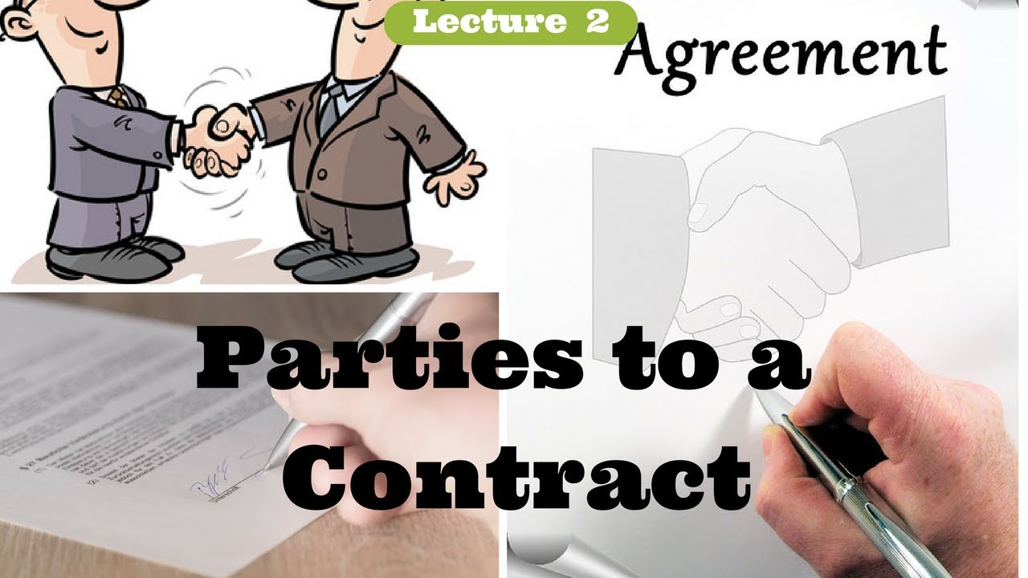
Parties to contract
The parties to a contract and those receiving of the contract may be different.
Similarly ,parties to a contract and the party from whom the consideration moves may also be different.
Let’s took an examples:
Example 1 :
B and C get into an agreement whereby B will transfer the ownership of his laptop to A and C will pay RS. 25,000 to B. B delivers the laptop to A ,but c refuses to pay B.

Slide 21
Example 2 :
Continue….
In this case , the consideration for b is Rs, 25,000 and for C , the undertaking of B to give the laptop to A. thus , both the parties have a consideration . It is incidental that a third party is benefiting from the contract .
B and C get into an agreement whereby A will transfer the ownership of his laptop to C and C will pay RS.25,000 to B.
In this case , the agreement is between B and C and the right and obligation should be on them . However, the consideration is moving from a third party A ,and not from B. For this reason ,under the common law ,the agreement between B and C is not binding.
The Indian contract Act 1872 ,however ,has made such contract valid.

Slide 22
Case Study :
Dunlop pneumatic Tyre Co. Ltd. V. Selfridge & Co. Ltd.
The case involves three parties , Dunlop pneumatic Tyre Co. Ltd. , Selfridge & Co. Ltd. And Dew co. Ltd. Dunlop was manufacturer of motor tyres and Dew was a dealer in motor accessories. Dunlop had a scheduled price for his products. It sold tyres to Dew at a discount 10 percent . Dew could sell the tyres to end users as well as to other retailers. Dunlop anted to ensure that the tyres do not get sold to the consumer at a price lower than the scheduled price. Towards this, Dunlop had a written agreement with Dew under which Dew could not sell the tyres to customers at a price lower than the scheduled price. In the event of a sale to a retailer or trade customer , Dew would take a written undertaking from that retailer or trade customer that the tyres would not be further re-sold at a price below the scheduled price. The text of the price maintenance agreement was provided by Dunlop. It stated : ‘We agree to pay to the Dunlop pneumatic tyre co. ltd. The sum of $5 for each and every tyre ,cover or tube sold or offered is breach of this agreement….’
Selfridge , a retailer of motor accessories , placed an order on Dew for Dunlop tyres. Dew obtained the tyres from Dunlop on the same day and delivered them with a price maintenance agreement to be signed by selfridge. The Agreement was signed by selfidge.

Slide 23
Continue….
It , however ,sold the tyres to its customers at a price lower than the scheduled price. Dunlop moved the court to restrain selfidge from further selling the tyres at a price lower than the scheduled price and claimed damages at rate of $5 each for the tyres sold .
Courte Decision : Dunlop not get relief from the court . The case brings out the following two principles of the common law :
1] Strangers to a contract have no rights ,even if the contract is for their benefit.
2] Consideration must move from the person who is claiming rights in a contract . Consideration moving from another person is not adequate.

Slide 24
THANK YOU

